Slide 1
Giovanni Eufracio
Class of 2016

Slide 2
About Me
Born in Lindsay May 5, 1998
Family of 4
Lived in Lindsay my entire life
I’m 5’5 in height

Slide 3
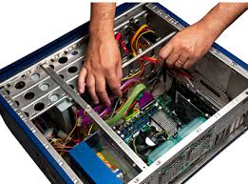
High School Experience
In FBLA
Regional conference
In Guitar Club
Honor’s group
In Computer Systems Repair
Take part in projects
PBS
Helpful in ways

Slide 4
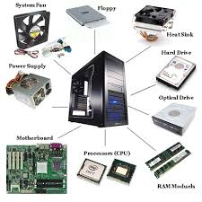
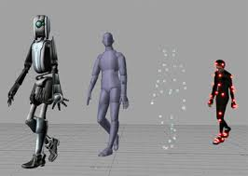
Pathway
My pathway is technology
Got my attention
Pathway interesting

Slide 5
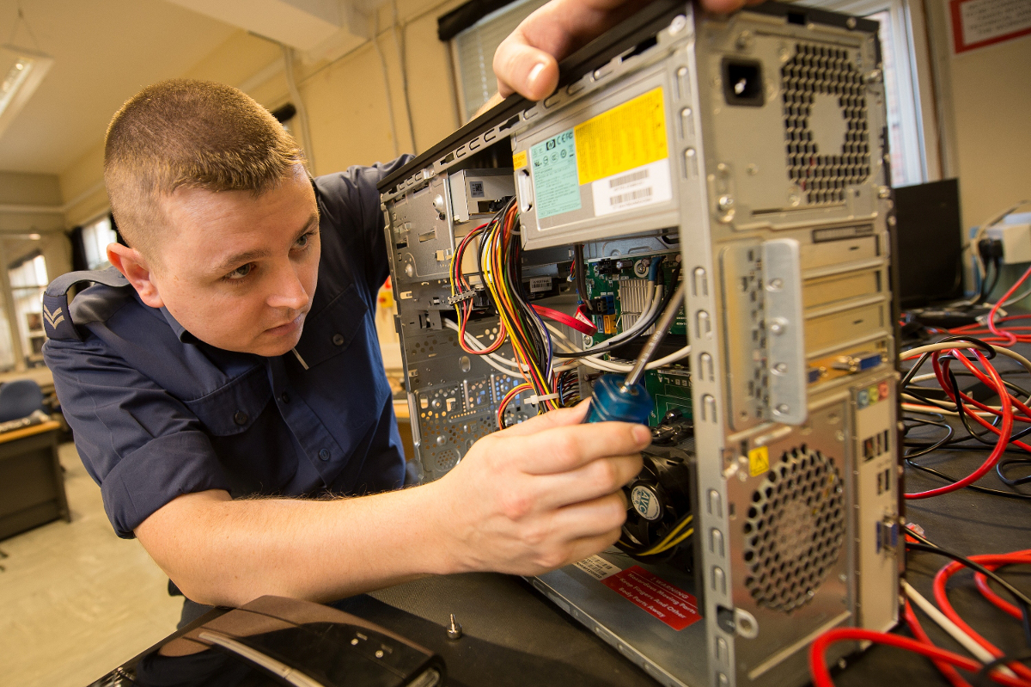
Job Shadow
Job shadowed IT Technician
Showed me their routine
Interested in this career

Slide 6
Post High School Plans
Go to COS
Transfer to ITT Tech or Art Institute
Start career in either PC technician or animator

Slide 7
Leaving LHS
LHS has shaped me
Learned a lot
Sad leaving

Slide 8
Questions
Thank you for your time any questions

